Slide 1

6th Grade Math
Unit 1, Lesson 1 Using Multiple Representations to Investigate Patterns Volume 1, pg. 3

Slide 2


Benchmarks
MA.5.AR.3.1
Given a numerical pattern, identify and write a rule that can describe the pattern as an expression.
MA.5.AR.3.2
Given a rule for a numerical pattern, use a two-column table to record the inputs and outputs.
MA.5.AR.4.2
Represent mathematical and real-world problems by plotting points in the first quadrant of the coordinate plane and interpret coordinate values of points in the context of the situation.
volume 1, pg. 3

Slide 3
Integrated Mathematical Thinking and Reasoning Standards
MA.K12.MTR.1.1 Actively participate in effortful learning both individually and collectively.
MA.K12.MTR.4.1 Engage in discussions that reflect on the mathematical thinking of self and others.
MA.K12.MTR.5.1 Use patterns and structure to help understand and connect mathematical concepts.
MA.K12.MTR.7.1 Apply mathematics to real-world contexts.
volume 1, pg. 3

Slide 4

Learning Targets
I can use multiple representations to investigate patterns found in tables or lists.
I can plot points on the coordinate plane.
volume 1, pg. 3

Slide 5

Warm-Up
volume 1, pg. 3

Slide 6
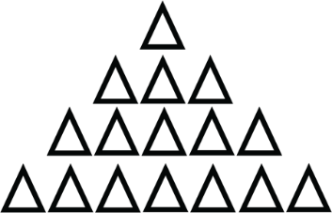
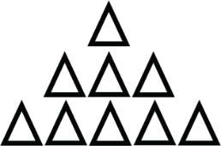
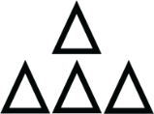

1.1.1 Warm-Up: Visual Patterns
The diagram shows four terms of a visual pattern.
What do you notice about the pattern?
How many rows of triangles do you think will be in Term 9?
Term 1
Term 2
Term 3
Term 4
volume 1, pg. 3

Slide 7
How many of the small triangles do you think will be in the pattern for Term 9?
How many of the small triangles do you think will be in the pattern for Term 15?
volume 1, pg. 3

Slide 8

Guided Instruction
volume 1, pg. 4

Slide 9
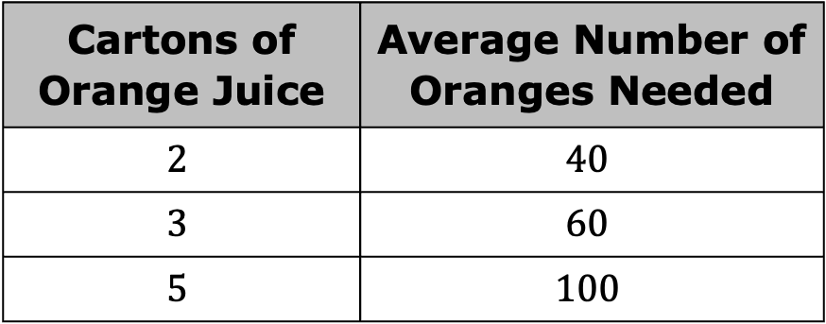
1.1.2 Guided Instruction: Using Multiple Representations to Investigate Patterns
A team of mathematicians at an orange juice manufacturer in Florida is collecting information on how many oranges are needed to make orange juice.
The table shows the information the mathematicians have recorded so far.
Cartons of Orange Juice | Average Number of Oranges Needed
$$2$$ | $$40$$
$$3$$ | $$60$$
$$5$$ | $$100$$
volume 1, pg. 4

Slide 10
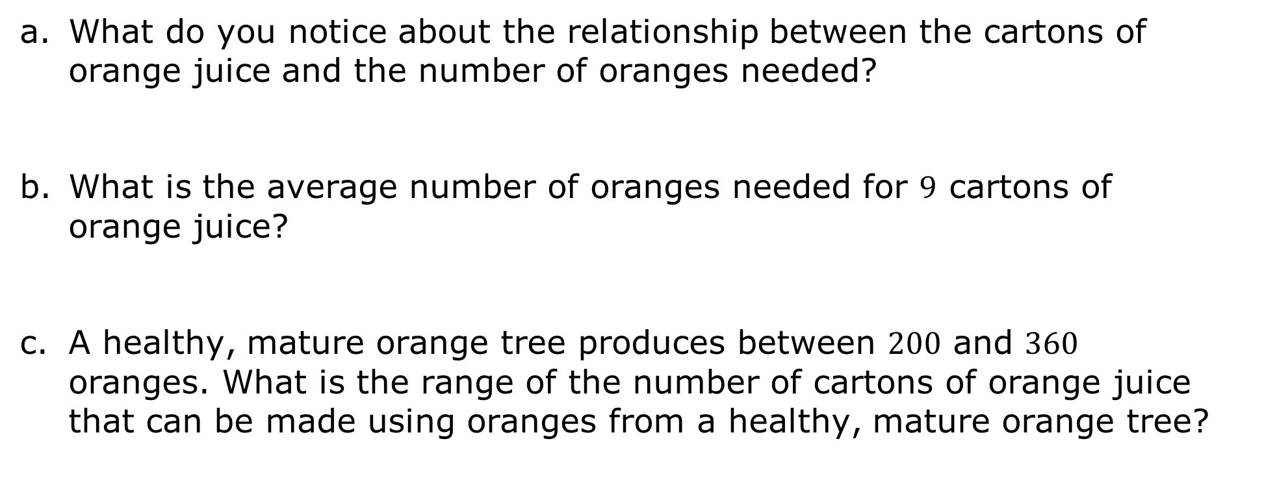
What do you notice about the relationship between the cartons of orange juice and the number of oranges needed?
What is the average number of oranges needed for $9$ cartons of orange juice?
A healthy, mature orange tree produces between $200$ and $360$ oranges. What is the range of the number of cartons of orange juice that can be made using oranges from a healthy, mature orange tree?
volume 1, pg. 4

Slide 11
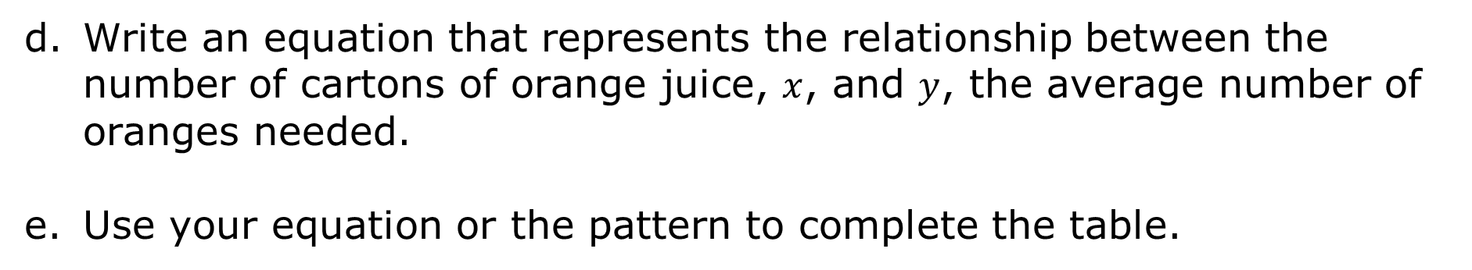
Write an equation that represents the relationship between the number of cartons of orange juice, $x$, and $y$, the average number of oranges needed.
Use your equation or the pattern to complete the table.
Cartons of Orange Juice | Average Number of Oranges Needed
1
2 | 40
3 | 60
4
5 | 100
volume 1, pg. 4

Slide 12
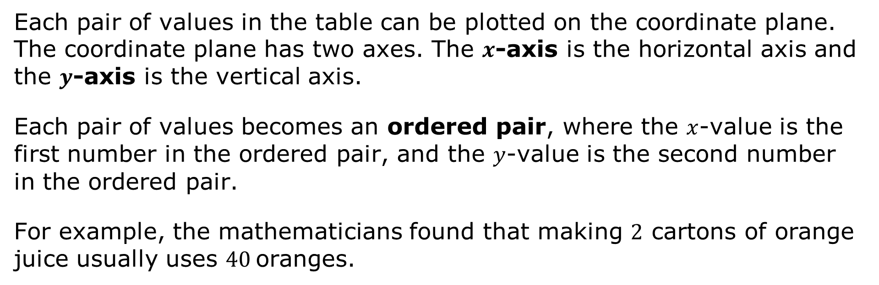
Each pair of values in the table can be plotted on the coordinate plane. The coordinate plane has two axes. The $x$-axis is the horizontal axis and the $y$-axis is the vertical axis.
Each pair of values becomes an ordered pair, where the $x$‑value is the first number in the ordered pair, and the $y$‑value is the second number in the ordered pair.
For example, the mathematicians found that making $2$ cartons of orange juice usually uses $40$oranges.
volume 1, pg. 5

Slide 13
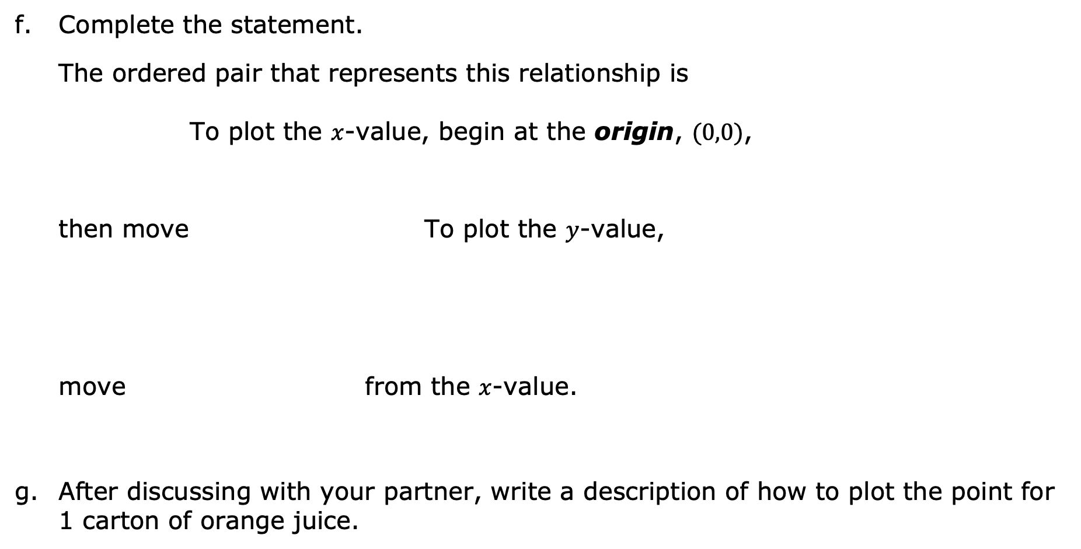
Complete the statement.
The ordered pair that represents this relationship is To plot the $x$-value, begin at the origin, $(0,0)$,
then move To plot the $y$-value,
move from the $x$-value.
After discussing with your partner, write a description of how to plot the point for 1 carton of orange juice.
(2, 40).
(40, 2).
up 2 units.
right 2 units.
right 40 units.
up 40 units.
up 2 units.
right 2 units.
right 40 units.
up 40 units.
volume 1, pg. 5

Slide 14
Plot each point from the table on the coordinate plane below.
Number of Cartons of Orange Juice
200
180
160
140
120
100
80
60
40
20
Average Number of Oranges Needed
2 | 4 | 6 | 8 | 10 | 12 | 14 | 16 | 18 | 20 | 22 | 24 | 26 | 28 | 30
Number of Cartons of Orange Juice
volume 1, pg. 5

Slide 15
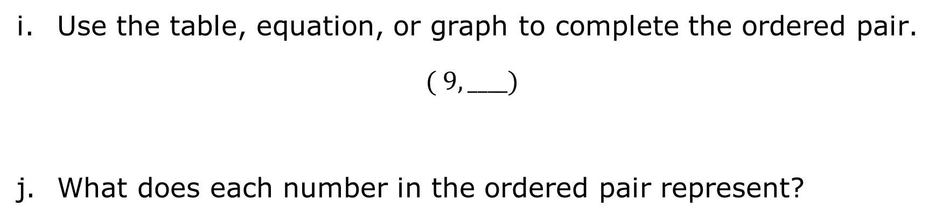
Use the table, equation, or graph to complete the ordered pair.
$$( 9, ____)$$
What does each number in the ordered pair represent?
volume 1, pg. 5

Slide 16

Guided Practice
volume 1, pg. 6

Slide 17

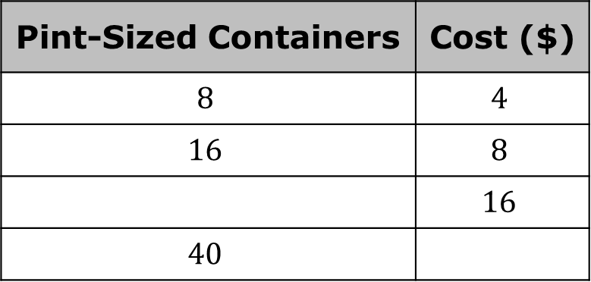

1.1.3 Guided Practice: Investigating Patterns
The orange juice manufacturer decided to offer orange juice in pint-sized containers. Each $8$-pack of pint-sized containers will be sold for $\$4$.
Use the pattern in the table to find the missing values.
Write an equation to represent the relationship between the number of pint-sized containers, $x$, and the cost in dollars, $y$.
Pint-Sized Containers | Cost ($)
$$8$$ | $$4$$
$$16$$ | $$8$$
 | $$16$$
$$40$$
volume 1, pg. 6

Slide 18
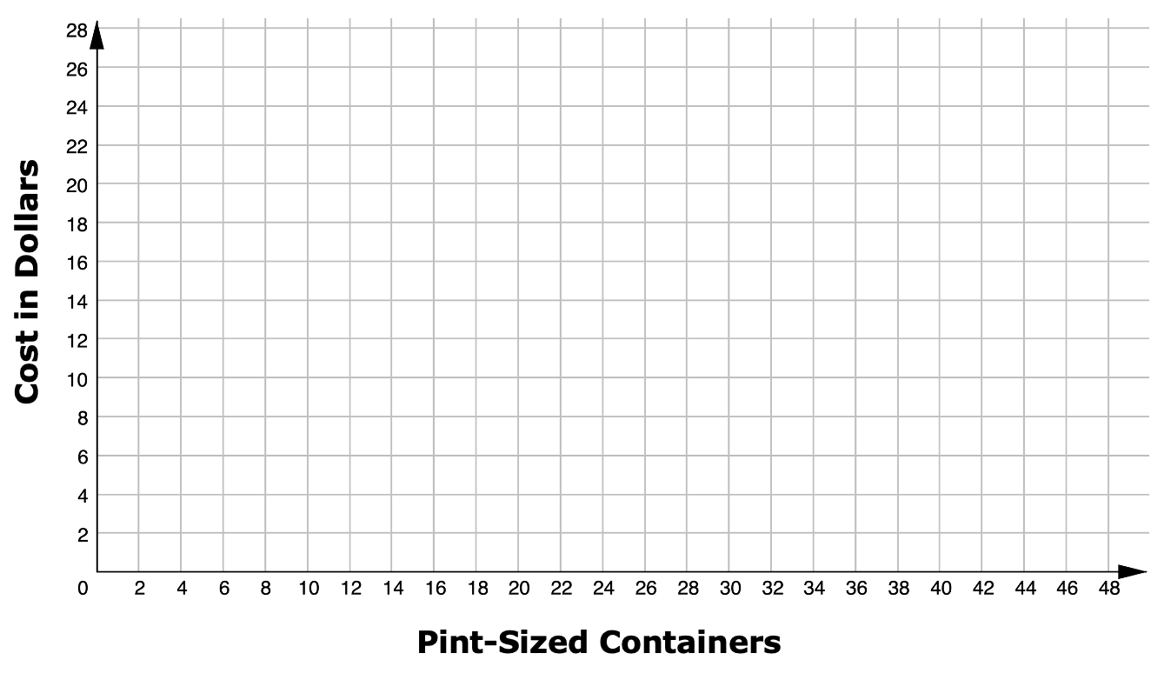
Use the coordinate grid to plot the ordered pairs in the table.
volume 1, pg. 6

Slide 19
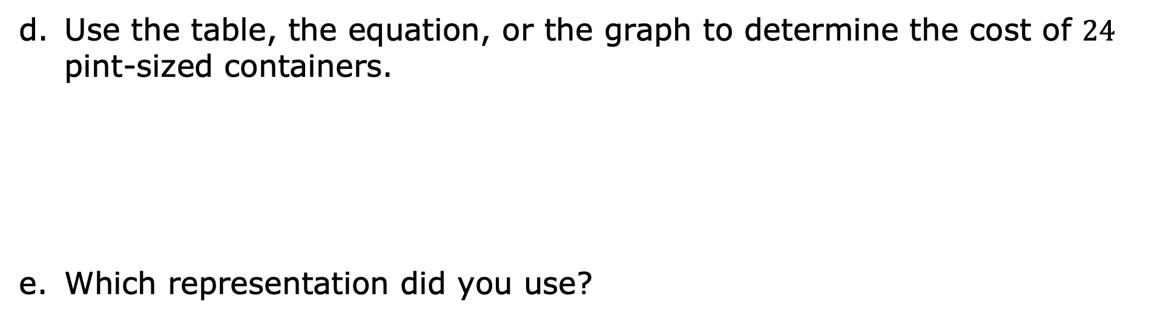
Use the table, the equation, or the graph to determine the cost of $24$ pint-sized containers.
Which representation did you use?
volume 1, pg. 6

Slide 20
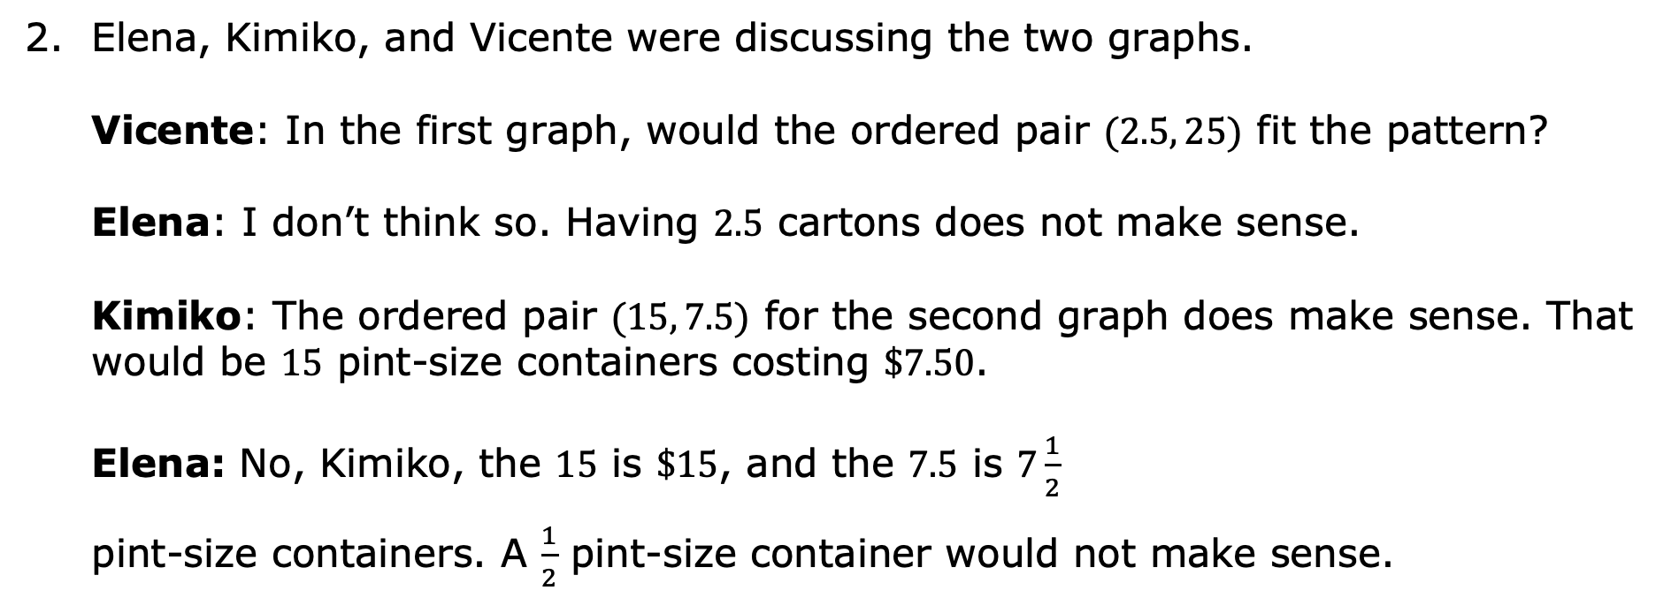
Elena, Kimiko, and Vicente were discussing the two graphs. Vicente: In the first graph, would the ordered pair $(2.5, 25)$ fit the pattern?
Elena: I don’t think so. Having $2.5$ cartons does not make sense. Kimiko: The ordered pair $(15, 7.5)$ for the second graph does make sense. That would be $15$ pint-size containers costing $\$7.50$. Elena: No, Kimiko, the $15$ is $\$15$, and the $7.5$ is $7\frac{1}{2}$
pint-size containers. A $\frac{1}{2}$ pint-size container would not make sense.
volume 1, pg. 7

Slide 21
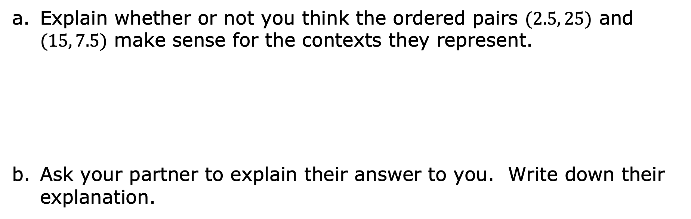
Explain whether or not you think the ordered pairs $(2.5, 25)$ and $(15, 7.5)$ make sense for the contexts they represent.
Ask your partner to explain their answer to you. Write down their explanation.
volume 1, pg. 7

Slide 22

Wrap-Up
volume 1, pg. 7

Slide 23
1.1.4 Wrap-Up: Reflection
For each pair of statements, check the statements that apply to your understanding.
I can use an expression to extend patterns.
I need support using an expression to extend patterns.
I can locate ordered pairs on a coordinate plane.
I need support in locating ordered pairs on a coordinate plane.
I can identify a pattern and write an expression to match.
I need support identifying a pattern and writing an expression to match.
volume 1, pg. 7

